Slide 1
Sprint 1 Status Update (Mid-sprint Submission 1)
Agile Sprinters
PUERTO RICO SEA LEVEL RISE CENTER - DATA PORTAL DASHBOARD
Class Date: 9/4/2024

Slide 2



team Members
Jainam Jagani Scrum Master
Veena Bathula Developer
Varsha Monala Product Owner
Ivan Francis Developer
Sai Manish Reddy Pannala Developer

Slide 3
YouTrack
Instructions: SCRUM Master will bring up YouTrack Project page and show Sprint 1 Board
Work with instructor prior to mid-sprint-1 presentation to define all user stories and tasks
All user stories must have a description, exit criteria, assigned to team member, and priority
All user story associated tasks must a description, exit criteria, assigned to team member, and priority
SCRUM Master will be responsible for placing task in the “In Progress” column when ready;
Assigned team member to task is responsible for placing comments and attachment in the task; this will be reviewed by the team member assigned to verify the task and instructor; part of sprint grade
Assigned team member to task moves task to “To Verify” column with task is complete assigns team member to verify the task
Assigned team member to verify task will review the task and either move it to “Done” column if it satisfies exit criteria or moves it back to “In Progress” column with comments why if failed and reassigns to previous task assignee

Slide 4
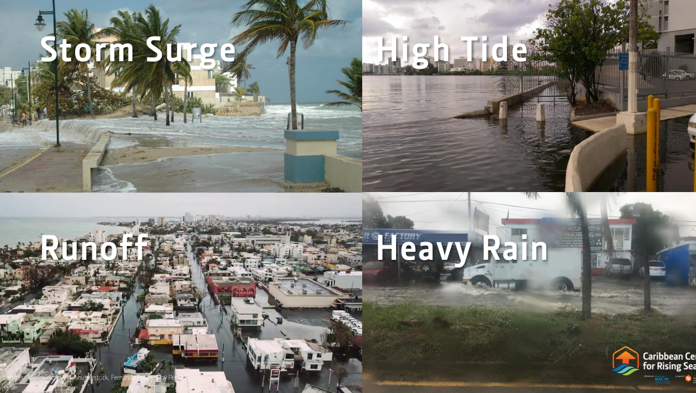
problem statement
Problem Context
Domain of the Problem:
Real Estate and Urban Development: Increased flooding and sea level rise threaten property values, safety, and long-term viability of coastal and flood-prone areas.
Infrastructure and Public Policy: Flooding challenges current infrastructure, requiring significant updates to transportation, utilities, and public services.
Environmental Management: Effective flood management is crucial to minimize ecological damage and protect natural habitats.
Community Health and Safety: Flooding poses risks to physical health, mental well-being, and the safety of communities.
Insurance and Finance: Rising flood risks increase insurance costs and financial burdens for homeowners, businesses, and governments.
Disaster Response and Emergency Management: More frequent and severe flooding events strain emergency services and disaster response systems.
Importance of the Problem: The increasing frequency and severity of flooding due to climate change led to significant economic, social, and environmental impacts. Without proactive measures, these problems will result in higher costs for recovery, loss of property and life, displacement of communities, and long-term socio-economic instability.
Problem Statement:
Increasing flood frequency and rising sea levels threaten the safety, infrastructure, and economic stability of coastal regions. Current policies and practices are insufficient to manage these risks, leading to higher costs and community disruption. A more cohesive strategy is required to build resilience and protect vulnerable areas from future flooding.
Nice to have: A graphic(s) relating to the problem space would be useful

Slide 5
Datasets
Proposed Datasets for Project
Dataset Name: ArcGIS Online Data
Dataset Owner: Esri (Environmental Systems Research Institute)
Dataset Type: Proprietary
Dataset Size: Variable (Depends on layers and analysis tools used; cloud-based access)
Dataset Name: Arkly Flood Risk Data
Dataset Owner: Arkly
Dataset Type: Proprietary
Dataset Size: Variable (Dependent on location and data granularity)
Dataset Name: NOAA Sea Level Rise Viewer Data
Dataset Owner: NOAA (National Oceanic and Atmospheric Administration)
Dataset Type: Open Source
Dataset Size: Variable (Data layers provided online; can be extracted as needed)
Dataset Name: Caribbean Center for Rising Seas (CCRS) Internal Data Sets
Dataset Owner: Caribbean Center for Rising Seas (CCRS)
Dataset Type: Proprietary
Dataset Size: Variable (Size depends on specific datasets; requires internal access)

Slide 6
Potential Analytics/algorithms
Community Resilience Scoring Algorithm
Analytic/Algorithm Name: Decision Tree, K-Means Clustering
Datasets:
U.S. Census Community Resilience Estimates (CRE): Vulnerability indicators
Whole Community Resilience Planning (WCRP) Data: Resilience planning
ArcGIS Online Data: Spatial and demographic layers
Computer Resources Required:
Medium CPU, RAM (16 GB+)
Laptop/desktop with GIS tools access
Training:
Decision Trees (training phase required)
Optimization:
K-Means: Elbow Method, Silhouette Score
Decision Trees: Pruning to avoid overfitting
Testing:
Decision Trees: Accuracy on unseen data

Slide 7
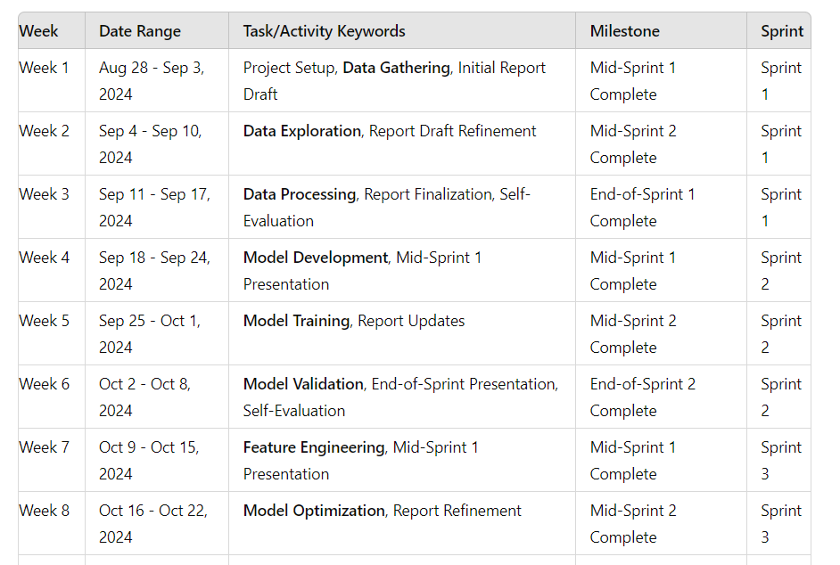
Project Schedule

Slide 8
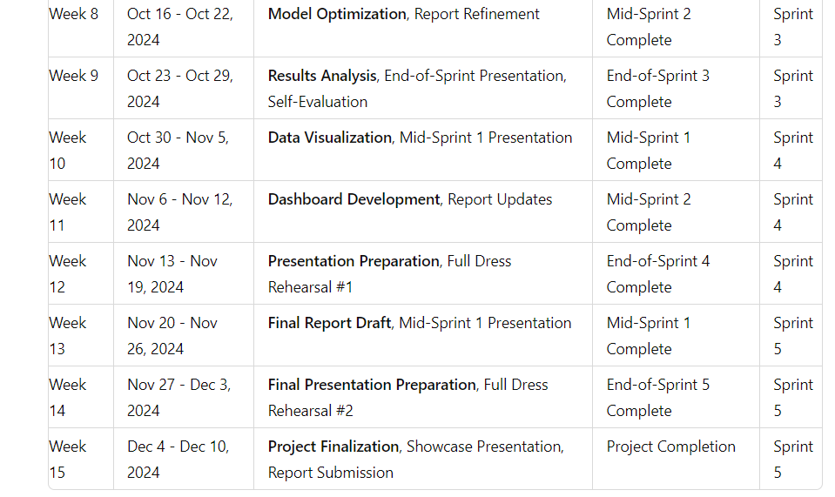
Project Schedule continue-

Slide 9
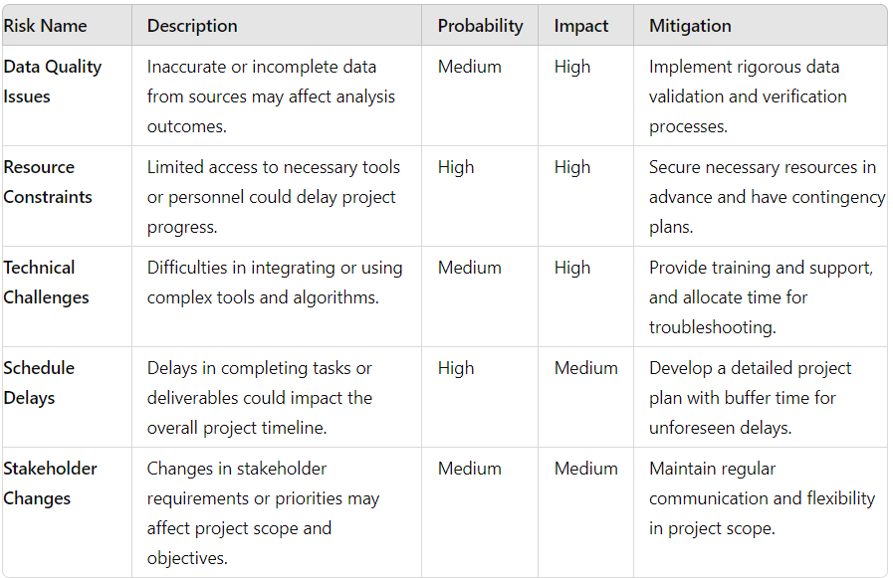
Risks and Planned Mitigations
Risk Name | Description | Probability | Impact | Mitigation
 | [brief] | [high, medium, low] | [high, medium, low] | [brief]

Slide 10
Weekly Partner Meeting
Carlos I. Gómez Borges, Engineering Specialist, cgomez@prsciencetrust.org
Brainstorming and Understanding the problem in detail.
Working on the data we have about the project and coming up with the problem statement
Get more information from the client on the dataset and set clear tangibles that the team can work on.

Slide 11

End of Presentation

